Slide 1


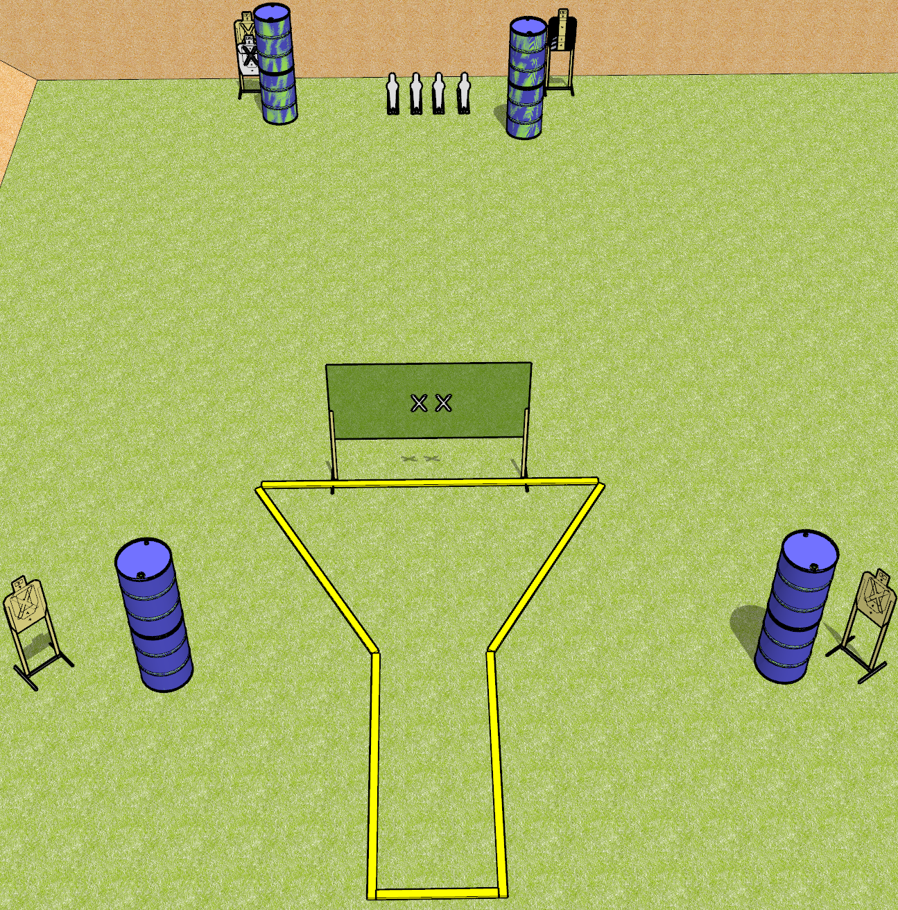
 | Dothan Gun Club – USPSA Match Beaker Course Designer : Drew Coleman
START POSITION : Hands touching both X’s. PCC muzzle touching either X
GUN READY CONDITION : Pistol has loaded magazine inserted with an empty chamber, hammer down. PCC has loaded magazine inserted with an empty chamber, safety on, shouldered, held with box hands, muzzle touching either X. |  | SCORING: Comstock, 12 rounds TARGETS: 4 paper, 4 Steel SCORED HITS: Best 2 on paper, steel until down START-STOP: Audible, last shot RULES:
STAGE PROCEDURE: Engage targets as they become available from within the fault lines.

Slide 2
Beaker
Written Stage Briefing
Beaker is a 12 round, 60 point, Comstock short course. There are 4 USPSA targets and four USPSA mini poppers. The best two hits on paper will score, and steel must fall to score. The start signal is audible.
Handgun start position is both hands touching X’s. Handgun has loaded magazine inserted with an empty chamber, hammer down.
PCC start position is muzzle touching either X. Loaded magazine is inserted with an empty chamber, safety on. PCC is shouldered, held with both hands.
Stage Procedure

Slide 3
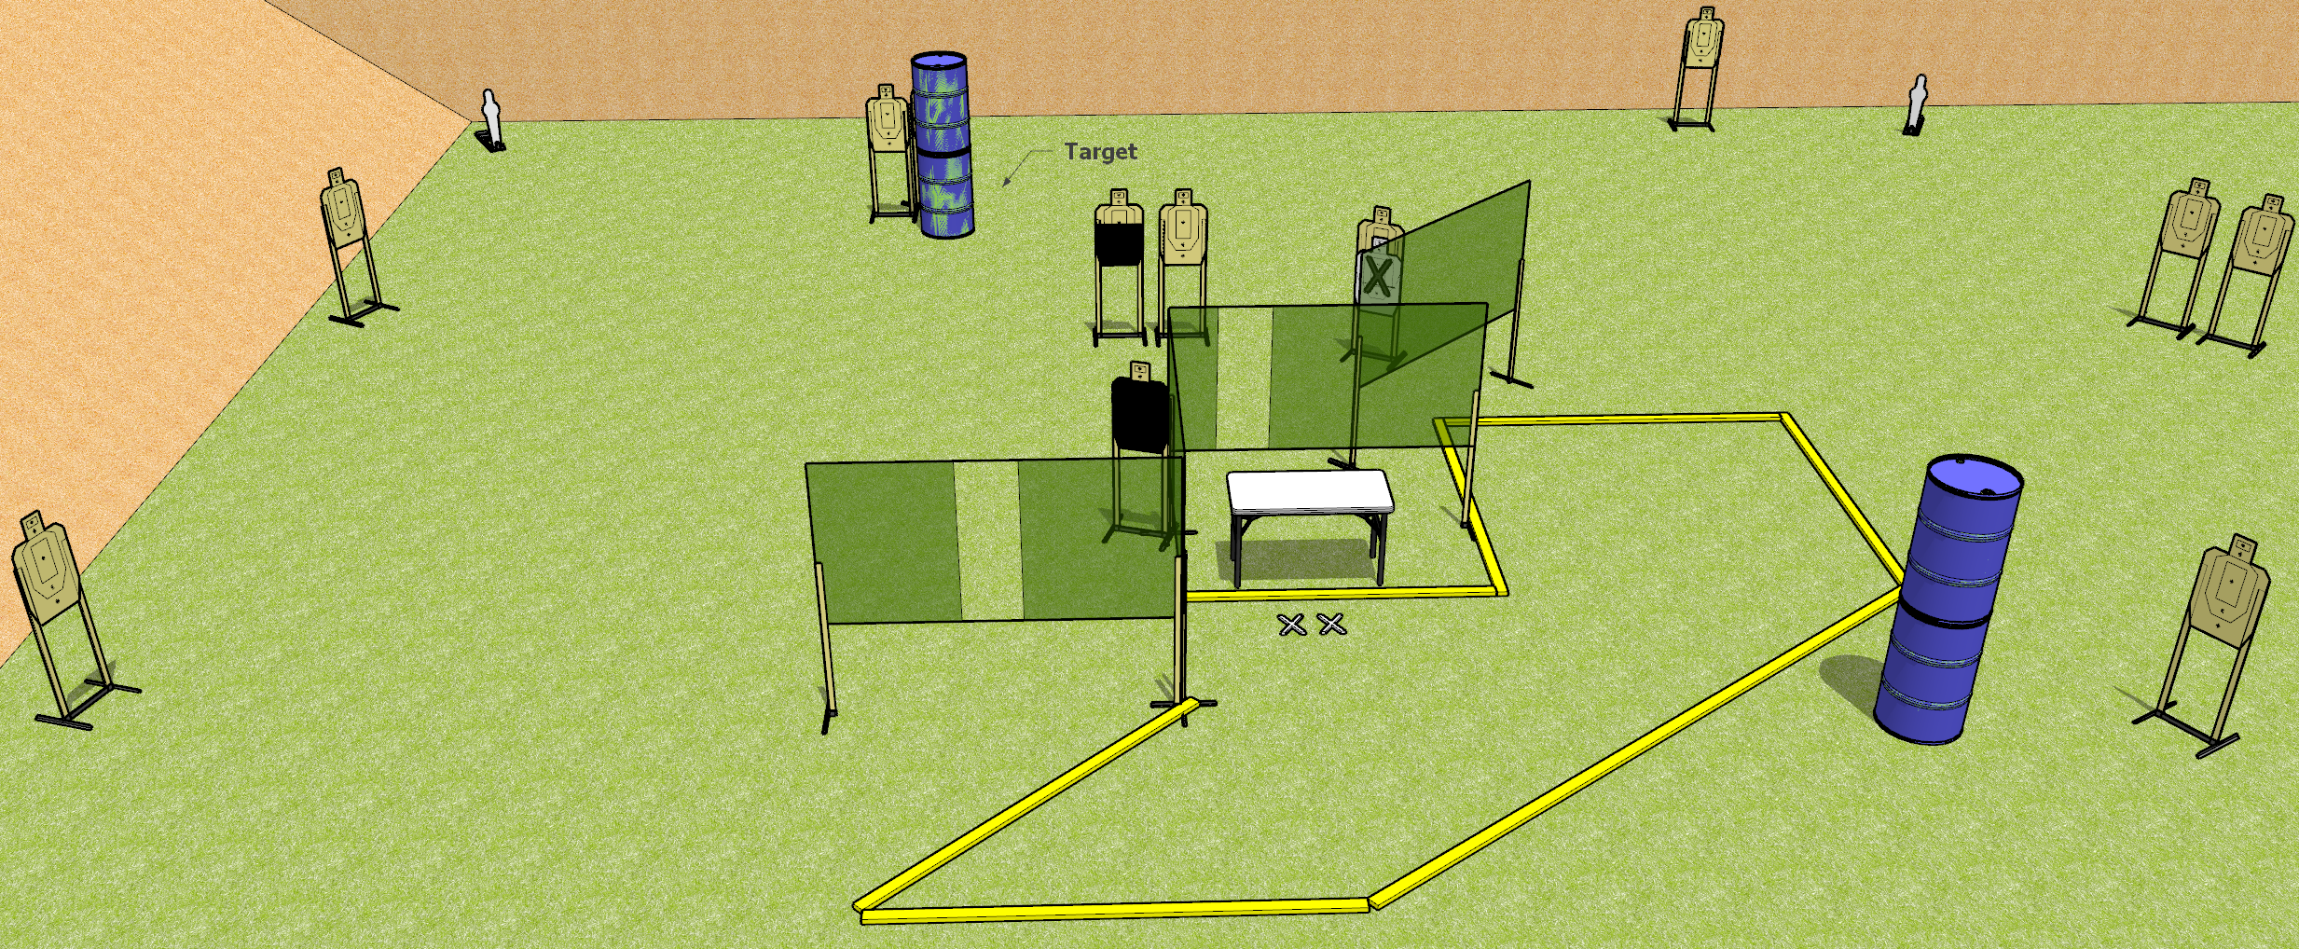
 | Dothan Gun Club – USPSA Match All on the Table Course Designer : Drew Coleman
26 rounds 12 USPSA Targets 2 USPSA mini poppers
12 target stands 6 wall feet 1 table

Slide 4
All on the Table
Written Stage Briefing
All on the table is a 26 round, 130 point, Comstock field course. There are 12 USPSA targets and 2 USPSA mini poppers. The best 2 hits on paper will score, and steel must fall to score. The start signal is audible.
Start position is both feet on X’s, fingers touching ears. Firearm is unloaded on table trigger guard on mark, lying unsupported. All magazines to be used during the stage are on table.
On start signal, engage targets as they become available from within the shooting area.

Slide 5
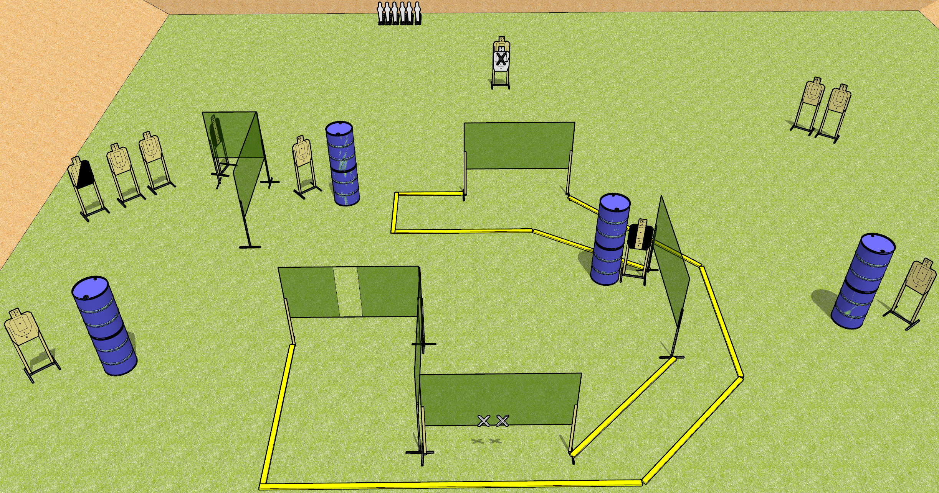
 | Dothan Gun Club – USPSA Match Just go Around Course Designer : Drew Coleman
Round Count 28 rounds 11 USPSA targets 6 mini poppers
Equipment List 11 wall feet 2 medium fault lines

Slide 6
Just Go Around
Written Stage Briefing
Just Go Around is a 28 round, 140 point, Comstock field course. There are 11 USPSA targets and 6 USPSA Mini Poppers. The best 2 hits on paper will score, and steel must fall to score. The start signal is audible.
Handgun start position is both hands touching X’s. Handgun is unloaded and holstered.
PCC start position is with muzzle touching either mark. Unloaded carbine is held with both hands, buttstock on belt, safety on.
On start signal, engage targets as they become available from within the shooting area.

Slide 7
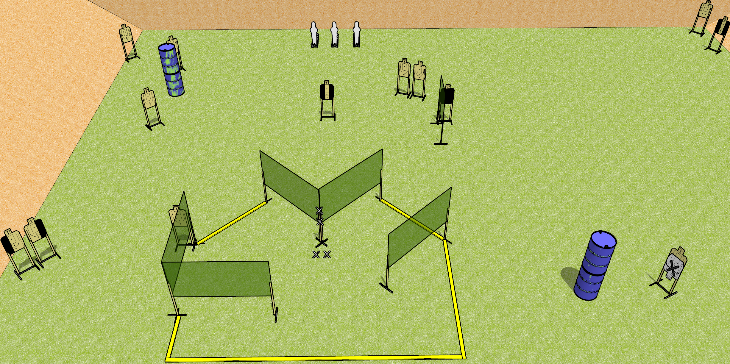
 | Dothan Gun Club – USPSA Match Nose on the Corner Course Designer : Drew Coleman
Round Count 29 Rounds 13 USPSA targets 3 pepper poppers
Equipment List 8 wall feet 1 medium fault line

Slide 8
Nose on the Corner
Written Stage Briefing
Nose on the Corner is a 29 round, 145 point, Comstock field course. There are 13 USPSA targets and 3 USPSA pepper poppers. The best two hits on paper will score and steel must fall to score. The start signal is audible.
Handgun start position is both hands touching marks on wall, feet on X’s. Handgun is unloaded and holstered.
PCC start position is muzzle touching lower mark, feet on X’s. Unloaded carbine is held with both hands, stock on belt.
On start signal, engage targets as they become available from within the shooting area.

Slide 9
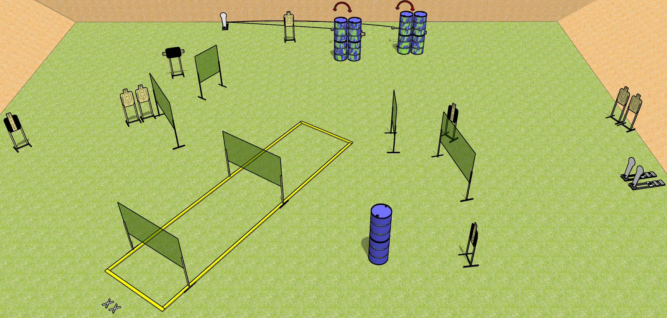
 | Dothan Gun Club – USPSA Match Speed Brake Course Designer : Patrick Free
START POSITION : Standing with both feet on X’s, wrists above shoulders
GUN READY CONDITION : Pistol loaded and holstered. PCC loaded, held with both hands, stock on belt, safety on. |  | SCORING: Comstock, 27 rounds TARGETS: 12 paper, 3 Steel SCORED HITS: Best 2 on paper, steel until down START-STOP: Audible, last shot RULES:
STAGE PROCEDURE: Engage targets as they become available from within the fault lines.

Slide 10
Speed Brake
Written Stage Briefing
Speed Brake is a 27 round, 135 point, Comstock field course. There are 12 USPSA targets and 3 Colt poppers. The best two hits on paper will score and steel must fall to score. The start signal is audible.
The swingers are activated by the leftmost colt popper and are not disappearing targets. Please check the activators prior to walkthrough and set them the same way every time.
Handgun start position is both feet on X’s, wrists above shoulders. Handgun is loaded and holstered.
PCC start position is both feet on X’s. Loaded carbine is held with both hands, stock on belt, safety on.
On start signal, engage targets as they become available from within the shooting area.

Slide 11
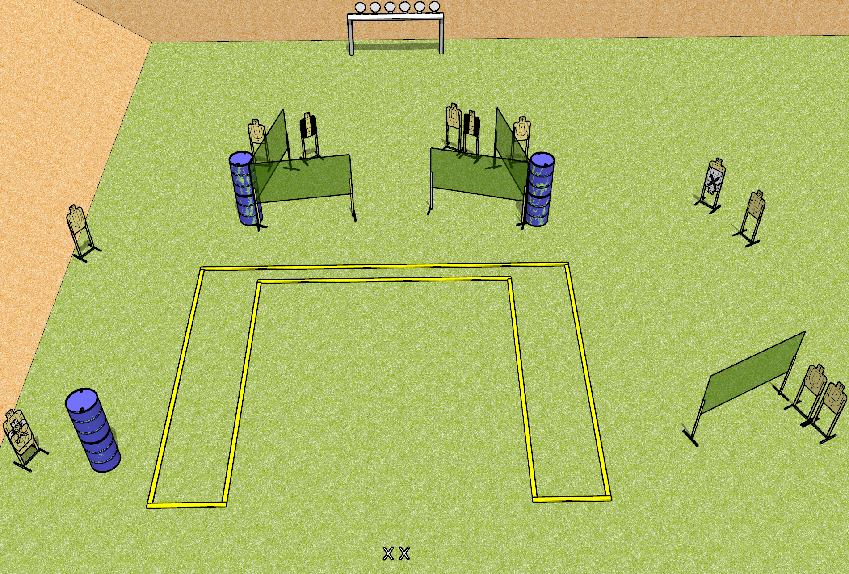
 | Dothan Gun Club – USPSA Match Upside Down Course Designer : Patrick Free
START POSITION : Standing with both feet on X’s, wrists above shoulders, facing uprange
GUN READY CONDITION : Pistol unloaded and holstered. PCC unloaded, stock on belt, facing downrange. |  | SCORING: Comstock, 30 rounds TARGETS: 12 paper, 6 Steel SCORED HITS: Best 2 on paper, steel until down START-STOP: Audible, last shot RULES: Setup note – post all paper targets upside down.
STAGE PROCEDURE: Engage targets as they become available from within the fault lines.

Slide 12
Upside Down
Written Stage Briefing
Upside Down is a 30 round, 150 point, Comstock field course. There are twelve USPSA targets and six falling plates. The best two hits on paper will score, and steel must fall to score. The start signal is audible.
Handgun start position is both feet on X’s, wrists above shoulders, facing uprange. Handgun is unloaded and holstered.
PCC start position is both feet on X’s. Unloaded carbine is held with both hands, stock on belt.
On start signal, engage targets as they become available from within the shooting area.

